Slide 1
CO3 AT2 TECHNICAL PRESENTATION
Name : Vedvyass M
Reg.no : 192324267
Subject : QUERY PROCESSING FOR DATA SCIENCE
Course Code : DSA0504

Slide 2
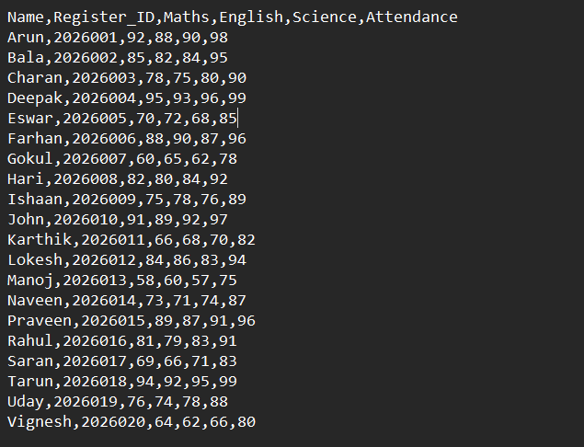

Slide 3
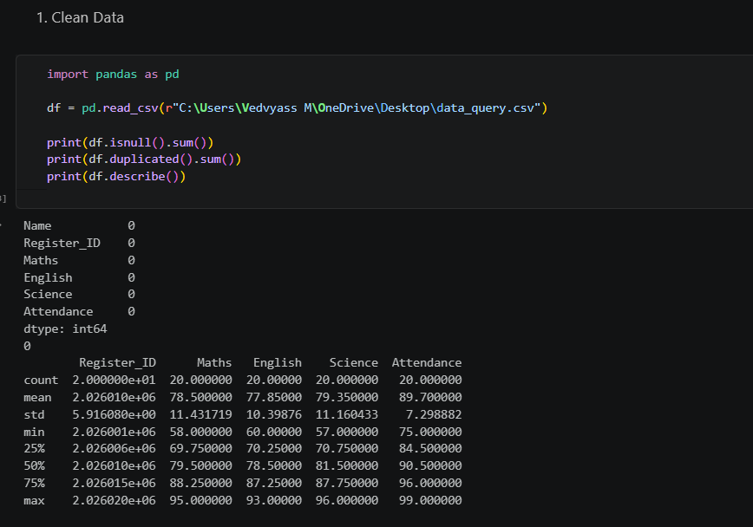

Slide 4
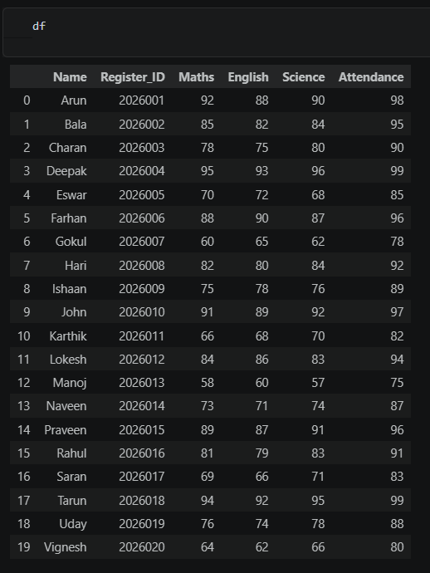
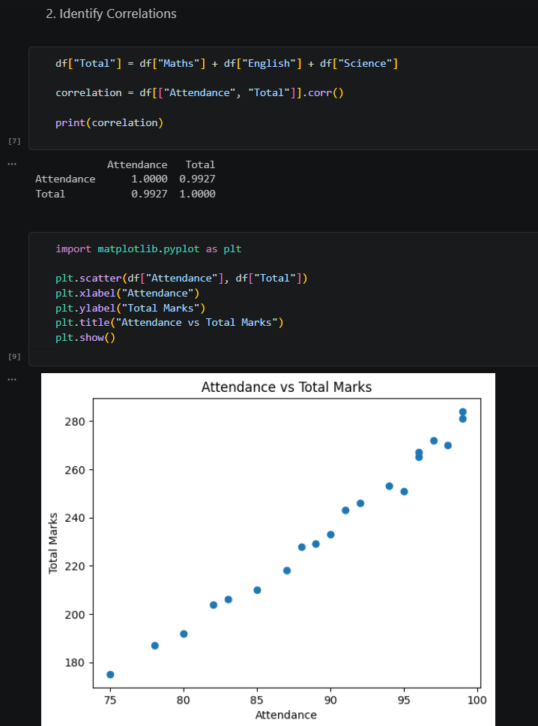

Slide 5
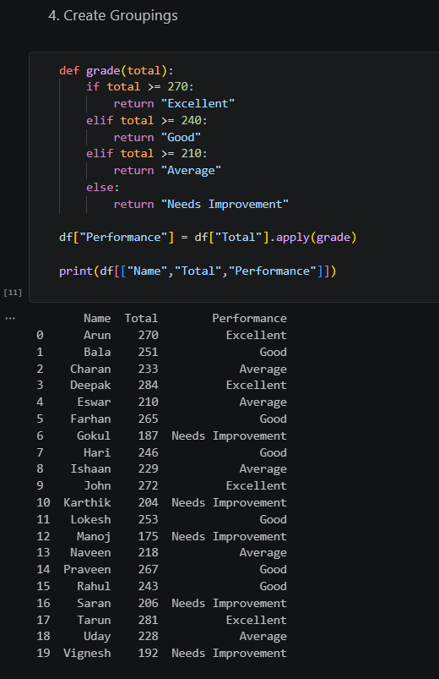

Slide 6
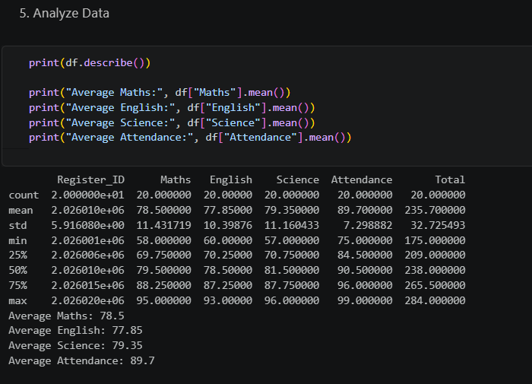

Slide 7
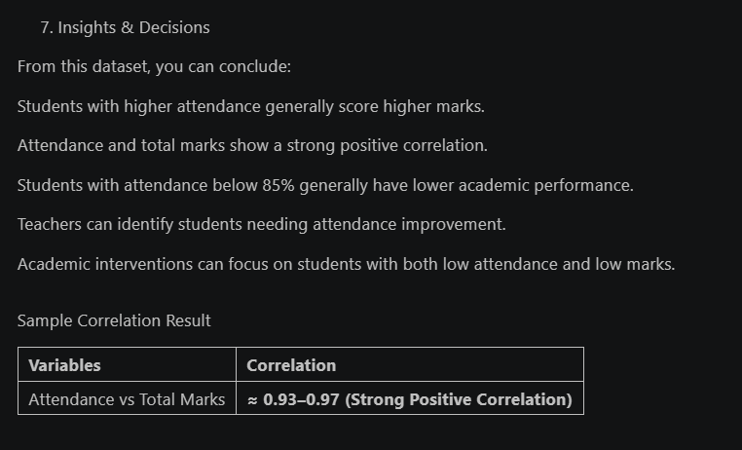

Slide 8
